Slide 1



TARIKHI
Tunisian Historical Sites API
Roéa Boubaker
BA/IT
Tunis Business School

Slide 2

plan
motivation
1.
technologies used
2.
security
3.
4.
website overview
impact
5.
next step
6.
conclusion
7.
1

Slide 3


01.
MOTIVATION
TUNISIA’S RICH HISTORICAL HERITAGE FACES ACCESSIBILITY CHALLENGES.
2

Slide 4

01.
MOTIVATION
INTERACTIVE WEB SERVICE FOR EXPLORING HISTORICAL SITES.
3

Slide 5







02.
TECHNOLOGIES USED
4

Slide 6


03.
SECURITY
JWT tokens for authentication.
Password hashing with bcrypt.
Role-based access control
5

Slide 7

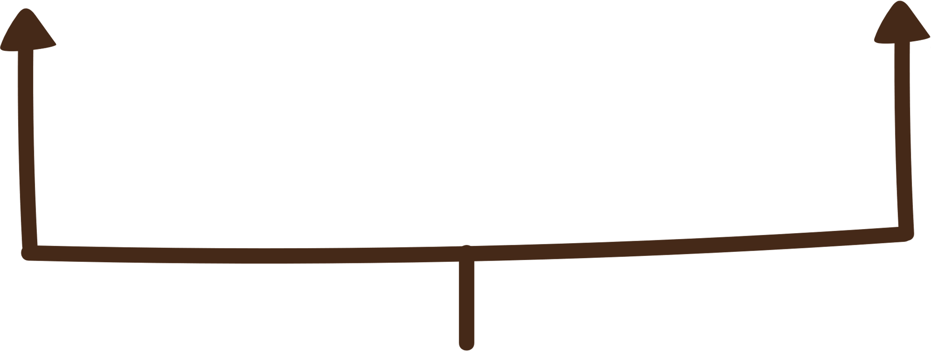
04.
WEBSITE OVERVIEW
SITE INFORMATION
DETAILED INFORMATION
"THEN & NOW" FEATURE
6

Slide 8

04.
WEBSITE OVERVIEW
USER INTERACTION
AUTHENTICATION
CONTRIBUTIONS
7

Slide 9

04.
WEBSITE OVERVIEW
MULTIMEDIA INTEGRATION
AUDIO NARRATIVES
VISUAL STORYTELLING
8

Slide 10

04.
WEBSITE OVERVIEW
SEARCH AND NAVIGATION
9

Slide 11
05.
IMPACT
1
2
3
Educational
Tourism
Heritage
10

Slide 12

05.
NEXT STEP
MULTILINGUAL SUPPORT
3D VIRTUAL TOURS
PARTNERSHIPS
INTEGRATION WITH AI
11

Slide 13
06.
CONCLUSION
"TARIKHI" IS NOT JUST A PROJECT BUT A STEP TOWARDS MAKING HISTORY ACCESSIBLE FOR ALL
13

Slide 14

THANK YOU

